Slide 1


Anxiety
Parent Workshop
West Hampshire Mental Health Support Teams
Emily Snushall and Kate Munday
Notes:
B – odd slides
Introduce ourselves and the MHST

Slide 2

Agenda
Welcome
What is anxiety?
When & why does anxiety become a problem?
Anxiety disorders
Causes of anxiety
Maintenance of anxiety
How to help your child
Helpful resources

Slide 3

Please Remember…
Be kind to yourself
Confidentiality - this is a safe space
No question is a silly question
We show respect to everyone
Non-judgemental
Notes:
R – Even slides
Confidentiality – there are families from different schools on this webinar so please be mindful about sharing personal information.
Questions – there are lots of people here today so we may not be able to answer questions. Please pop anything in the chat and we will try to get round to you. If you have any questions/feedback at the end, please speak to your MHL to send through to us.

Slide 4

What are you hoping to take away from today’s workshop?
Notes:
Feel free to put in the chat if there’s anything specific you’re hoping to get from today’s session
Rate your knowledge around anxiety and anxiety disorders using 0-10 scale 0 being no knowledge at all and 10 being I am an expert

Slide 5
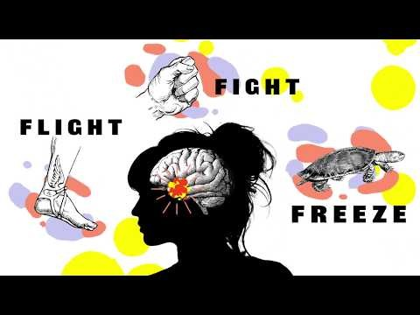

Slide 6

What is anxiety?
A natural evolutionary response
  Fight/Flight/Freeze
Experienced by everyone
It is meant to be helpful
Causes cognitive, physical, emotional, and behavioural responses to anxiety-provoking stimuli

Slide 7

Common Symptoms
Physical
Headache
Tummy ache
Sweaty palms
Heart beating faster
Dry mouth
Feeling sick
Behavioural Avoidance
Being quiet/withdrawn
Being more chatty
“Acting up”
Crying
Emotional
Worried
Upset
Stressed
Angry
Numb
Confused
Cognitive
Worries or negative thoughts about the anxiety-provoking situation, about their ability to cope, or about other peoples’ perceptions

Slide 8
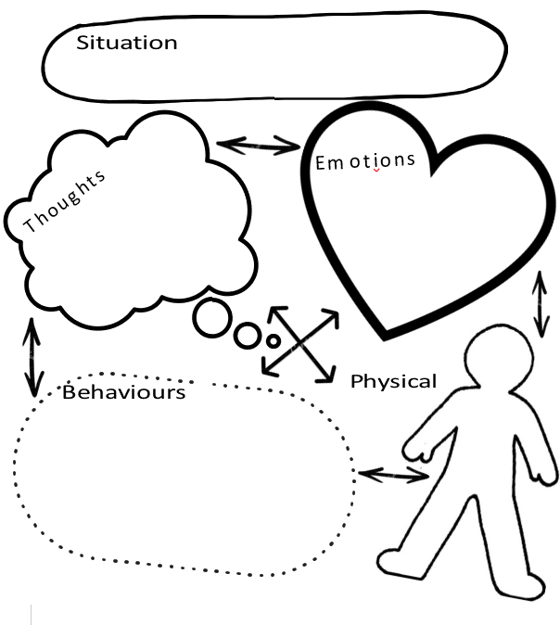
Notes:
Everything is linked!
You can’t change your emotions (“stop feeling anxious”) and you can’t change how your body reacts. But we can change how we think or behave in a situation. That’s what we’re going to look at today.

Slide 9

If anxiety is so useful then why does it become a problem?
Why?
The cognitive, physical, emotional, and behavioural responses to anxiety make the anxiety feel worse, and we feel unable to cope.
Anxiety has not evolved as fast as the world around us.
When?
When it is affecting daily functioning, and self-management has not helped
When social life, school attainment, and overall wellbeing is being impacted
Notes:
The cognitive, physical, emotional, and behavioural responses to anxiety make the anxiety feel worse, and make us feel unable to cope.
Anxiety begins to effect different parts of a person’s life such as social (friendships and family), school (Reduced attendance and attainment), and mood (mental wellbeing), when the person doesn’t know how to manage the anxiety.
Our anxiety is like a faulty fire alarm. Even when we are not presented with a threat or danger we can experience anxiety, because our brains have not developed at the same rate as the safe world that we live in today.

Slide 10
Different Types of Anxiety
Anxiety doesn’t come in one shape or form.
People have individual differences or experiences
There can be different or interacting causes
Anxiety can vary in intensity or severity
People may have different maintenance factors
There are 7 main types of anxiety disorder…
Specific Phobia
Separation Anxiety
Panic Disorder
Obsessive Compulsive Disorder (OCD)
Social Anxiety
Post Traumatic Stress Disorder (PTSD)
Generalised Anxiety Disorder (GAD)

Slide 11
What makes a child vulnerable to anxiety?
Life events or experiences
Genes
Learned behaviour
Temporary circumstances
Or a combination of these
Notes:
Why is my child vulnerable to anxiety?
Significant Life events - house move, bereavement, divorce and separation, change in schools, illness etc
Genes - We inherit characteristics such as eye and hair colour but also psychological characteristics e.g. impulsiveness, quick temper. It is known now that anxiety can run in families and it’s characteristics of anxiety they may inherit 1) How easily our body responds to threat - baby jumping to loud noises 2) how emotional we are generally - how easily a baby becomes distressed

Slide 12
What keeps the
anxiety going?
Avoidance
Safety behaviours
Reassurance
Missed opportunities for coping
Other people’s reactions / responses
Lack of confidence – specifically in
their ability to cope
Lack of independence
Worries becoming stuck

Slide 13
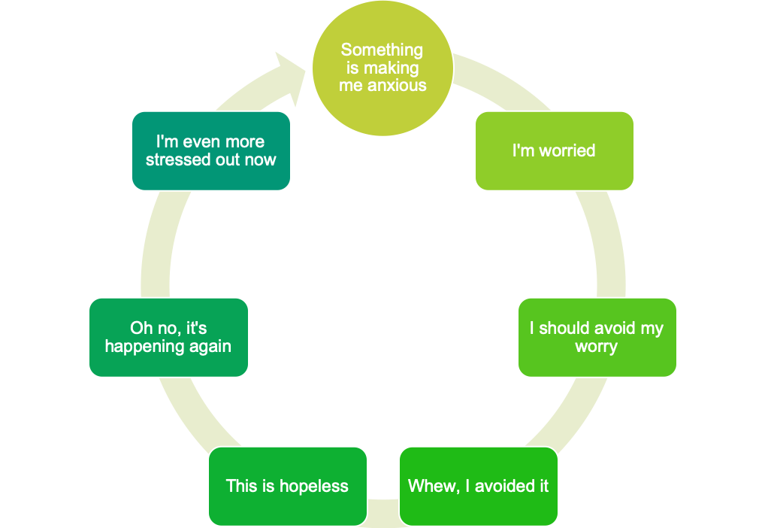

The Cycle of Avoidance
The anxiety feels worse because we have not learnt to cope with it
Worry goes unchallenged and we don’t know what to do about it
The trigger may never go away, but we can change how we manage our feelings about it
Avoidance causes short term relief reinforces the anxiety but eliminates a learning opportunity

Slide 14
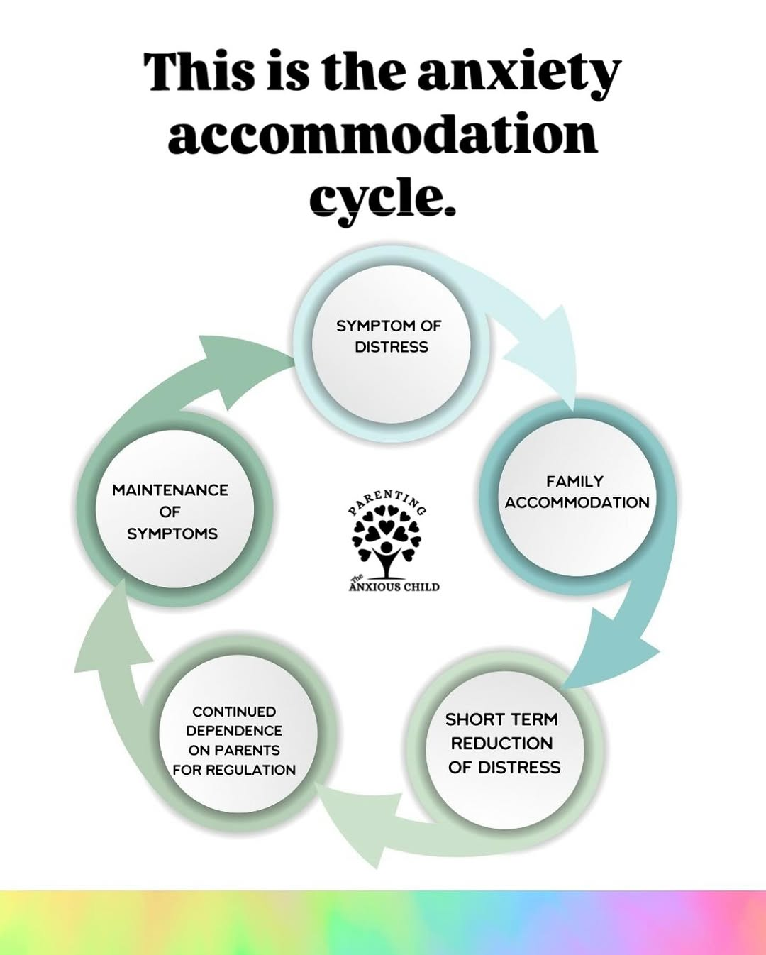
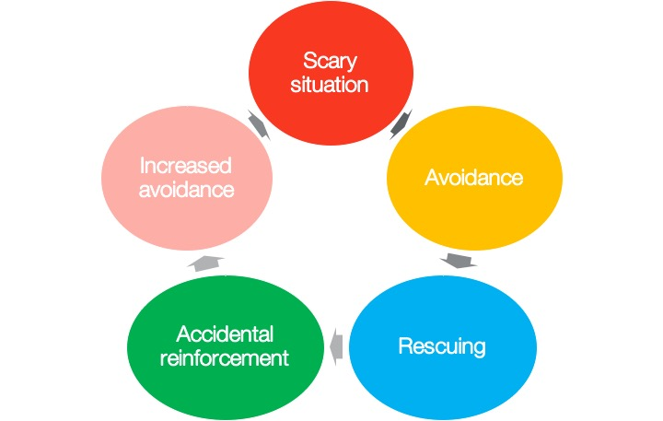

Slide 15

How can I help my child?

Slide 16
Educate Your Child
Educating them about anxiety helps them to understand what is happening and why they feel that way
Educating them lets them know that you understand
Educating them about what you can do to help them overcome anxiety helps them to know what they can expect

Slide 17
Monitor Your Responses
Be curious about their worries
Normalise and empathise
Reduce the reassurance that you give to encourage independent thinking
Be a role model
Notes:
Ask questions – be curious, ask questions instead of giving answers/solutions
Be understanding and compassionate
Do not reassure them – get them to come to their own conclusions
Model brave behaviour when trying new things or challenges, or talk to your child about how you’re feeling during the day to normalise

Slide 18
Take Steps to Improve Confidence and Resilience
Encourage independent behaviour
Encourage them to try new or challenging things
Use praise and rewards when they are brave or try new things
Try to encourage brave behaviour instead of avoidance where possible

Slide 19
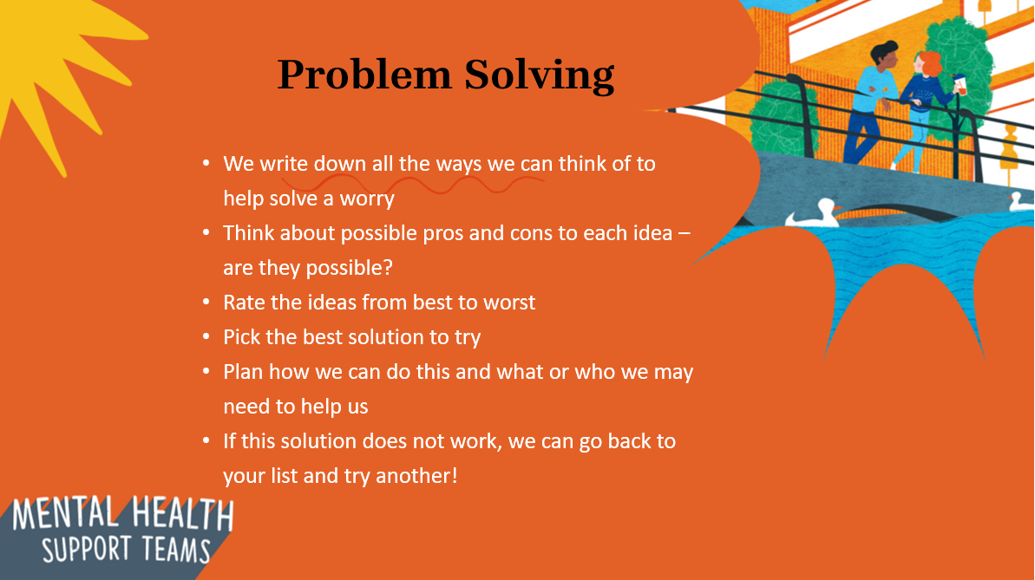
Problem Solving

Slide 20

Even if you don’t think your child is anxious now, you can begin using these strategies to prevent the onset of anxiety and promote their confidence and resilience.

Slide 21

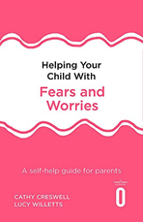
Helpful Resources
Apps:
Mindshift
Headspace
Self help for anxiety management (SAM)
Worry Box
Hampshire CAMHS How To Beat Anxiety Workbook – www.hampshirecamhs.nhs.uk
Books:
Helping Your Child with Fears and Worries by Cathy Cresswell and Lucy Willetts
What To Do When You Worry Too Much by Dawn Huebener

Slide 22
If you need further help…
You can speak to your school’s Mental Health Lead about a potential referral to the Mental Health Support Team.
Notes:
Once you’ve tried the things listed before.

Slide 23


Questions…

Slide 24
What will you take away from today’s session?
Have we covered what you wanted to gain?
Is there anything that you will change as a result of your learning?
Notes:
Speak to your MHL if you have any questions or feedback – unfortunately we won’t have time for questions today.
Take a moment to reflect on these questions and consider if you have learnt anything

Slide 25
Thank you
for listening

