Slide 1


Parent Workshop on anxiety
Mental Health Support Team
Notes:
KM
Introduce ourselves and the MHST

Slide 2

Agenda
Welcome
What is anxiety?
When & why does anxiety become a problem?
Anxiety disorders
Causes of anxiety
Maintenance of anxiety
How to help your child
Helpful resources
Notes:
KM
Flip chart paper- What would you like to know from today?
We can come back to and check at the end to make sure that we covered.

Slide 3

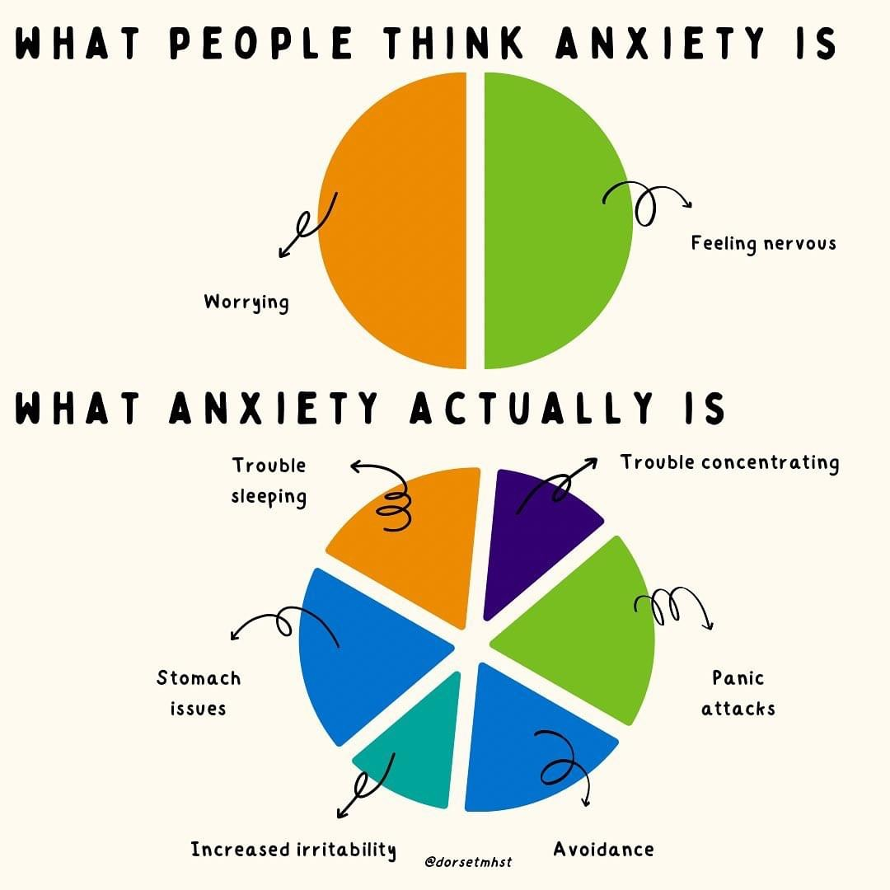
What is anxiety?
A natural evolutionary response
  Fight/Flight/Freeze
Experienced by everyone
It is meant to be helpful
Causes changes to our thoughts, feelings and behaviours
Notes:
Feelings of anxiety are actually are body trying to help us when we perceive there is a threat
You might be able to identify how your child responds or even how you respond when you're anxious
Anxiety can be Helpful - motivation for you or your child to practice a musical instrument, revision or homework tasks, when you are applying for a new job, even attending the session today
HF

Slide 4

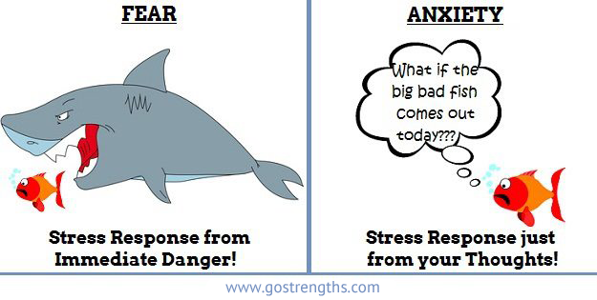
Fight, flight or freeze
When we are in an anxiety-provoking situation, our in-built alarm system goes off, which tells us to fight, flight or freeze to keep ourselves safe.
However, it can also be set off when we are not in danger.
Notes:
Our anxiety is like a faulty fire alarm. Even when we are not presented with a threat or danger we can experience anxiety, because our brains have not developed at the same rate as the safe world that we live in today.
HF

Slide 5

What are some of your child’s symptoms of anxiety?
Behaviours
Thoughts
Physical
Emotions
Notes:
KM-
Flip cart paper- What symptoms/ signs do you notice?

Slide 6
Common Symptoms
Physical
Headache
Tummy ache
Sweaty palms
Heart beating faster
Dry mouth
Feeling sick
Behavioural Avoidance
Being quiet/withdrawn
Being more chatty
“Acting up”
Crying
Emotional
Worried
Upset
Stressed
Angry
Numb
Confused
Thoughts
Worries or negative thoughts about the anxiety-provoking situation, about their ability to cope, or about other peoples’ perceptions
Notes:
KM
When we are talking about anxiety and wanting to understand why it has such an impact on our life, we consider 4 important components, which are:
Physical symptoms: what we feel in our body (children are likely to believe that they are unwell)
Emotions: the way how we feel, for example anxiety, stress, anger
Cognitions/ Thoughts: the things going on in our mind
Behaviour: what we might do/or not do, how we respond to the situation
It’s ok to feel anxious sometimes as this is a normal feeling that keeps as alert and motivates us to do things but when we worry to much, when the thoughts, feelings, and physical sensations are overwhelming this is when it may be helpful to reach out for support
All these 4 components have strong links and impact on each other
You might be able to identify some of these examples that your child experiences or some that are not on the lists your child has shared with you

Slide 7
Thoughts
Emotions
Physical
Behaviours
Notes:
KM Everything is linked! Whirlpool analogy- stirring tea
You can’t change your emotions (“stop feeling anxious”) and you can’t change how your body reacts. But we can change how we think or behave in a situation. That’s what we’re going to look at today.

Slide 8
Different Types of Anxiety
Anxiety doesn’t come in one shape or form but there are some more common types of anxiety.
Separation Anxiety – being anxious to separate from a care giver
Social Anxiety – being anxious that they will be perceived negatively by others
Worries/ Generalised Anxiety – lots of different topics and usually ‘what if?’
Notes:
HF

Slide 9

What makes a child vulnerable to anxiety?
Genes (around one third)
Life events or experiences
Learned behaviour
Temporary circumstances
(or a combination of these)
Notes:
KM
Significant Life events - house move, bereavement, divorce and separation, illness etc make us very anxious but also make our children anxious.
Genes - We inherit characteristics such as eye and hair colour but also psychological characteristics e.g. impulsiveness, quick temper. It is known now that anxiety can run in families. It is not anxiety they inherit, but the characteristics, such as being more sensitive to have the fight flight response. However, only one third of anxiety can ever be explained by genetics.
Learned behaviour – Children are great observers and even when we think they can’t see what we do or hear what we say, they are. They learn from our behaviour. For example, I am scared of dogs and my son was not scared of dogs till he saw my reaction in the situation when a dog jumped on me in the park. From that moment he learnt that dogs are dangerous and he should be afraid too. This is one example of how a child might pick up a fear from observation.
Temporary circumstances – for example transitions to school, change in routine, birthday parties. We would think it is something exciting and should make us feel happy but sometimes where children have kind of social anxiety and don't like to be around people they might feel anxious even when they have their own birthday party.

Slide 10

When does anxiety become a problem?
It is common for younger children to feel anxious around drop-off. There may be many factors leading them to feel anxious, such as separating from their care giver.
But if the anxiety is causing distress that gets in the way of every day life, stops them from taking part or attending school, this may be a sign to try some additional strategies.
Notes:
HF

Slide 11
What keeps the
anxiety going?
Avoidance
Safety behaviours
Reassurance
Missed opportunities for coping
Lack of confidence – specifically in
their ability to cope
Lack of independence
Worries becoming stuck
Notes:
KM
Safety behaviours are things that people do or use to make a situation easier to cope with or overcome. E.g. cuddly toys, reassurance, adult support
Draw the Worry Hill

Slide 12
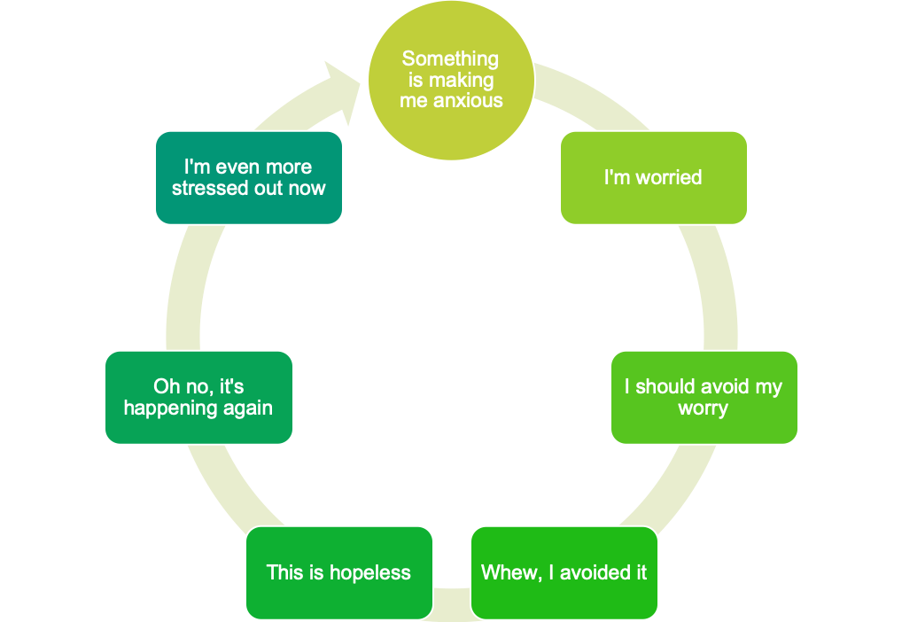

The Cycle of Avoidance
The anxiety feels worse because we have not learnt to cope with it
Worry goes unchallenged and we don’t know what to do about it
The trigger may never go away, but we can change how we manage our feelings about it
Avoidance causes short term relief reinforces the anxiety but eliminates a learning opportunity
Notes:
HF
This diagram helps to explain how avoiding a situation that causes anxiety can lead to the anxiety being maintained.
e.g. your child doesn't want to go to school because they don't they are going to have a good day.
They have physical symptoms and feel worried, and think the best solution is to not go and avoid what is worrying them.
Instant relief and may start to feel better UNTIL the next time they feel like this (trigger has not gone away and they will have to face it again)
Can lead to an increase in anxiety because it has not been tested or challenge for the child to learn that they can cope

Slide 13

How can I help my child?

Slide 14
Help your child understand
Help them to understand what they are feeling
  Naming emotions
  Make suggestions
  Talk about your own emotions
Let them know that anxiety is a normal emotion
Empathise, e.g. ‘I can see you are feeling…’
Notes:
HF
If we think back to what we have covered in the previous section, you could share the video with your child to introduce and open up discussion around what anxiety is and where is comes from.
Could draw out the 4 boxes - physical/ behaviours/ emotional/ cognitions
Complete a personal example for your child
Remember when completing this - your child might struggle to identify emotions - could use emoji lists to help them.
Opening up the conversation about their feelings and worries helps them feel validated in their emotions and that they are being listened to

Slide 15
Reducing Reassurance
Try to avoid jumping in to reassure or problem solve
Ask questions
Focus on positives, e.g. ‘It sounds like there are lots of fun things happening at school today’
Support your child to learn they can cope, e.g. ‘You were worried yesterday but had a good day, maybe that shows us today will be good too’
Notes:
KM

Slide 16
Take Steps to Improve Confidence and Resilience
Encourage independent behaviour
Encourage them to try new or challenging things
Use praise and rewards for brave behaviour
Encourage your child to break the avoidance cycle
Notes:
HF
Look for opportunities for them to be independent - washing up/helping to cook, tidying up room, making a bed , helping with shopping – please remember these activities must be age-appropriate
Encourage them to try new or challenging things. Think about smaller steps if something feels too big to overcome e.g. when your child is nervous about asking a question in class you can break the challenge down so the smaller step might be to ask the teacher a question at break time when there are no other children around. Then the next step might be to ask a question in a small group and so on.
This is something that could be shared with the teacher to help make plans around this being successful.
It is helpful to acknowledge success with a small reward that matches the difficulty in overcoming the fear – Rewards don’t have to be money new tablet or an exclusive holiday. They can be as small as having an extra special time with parents and going to the park, to the beach, or to the cinema. To collect points or stickers and achieve their goal by the end of the week they might choose their favourite game to play on.

Slide 17
What would this look like at drop off?
Letting them know you understand
Validating that their experience is real
Focusing on the positives, e.g. 3 good things
Checking in with your own emotions
Avoiding giving an ‘escape route’
Notes:
HF

Slide 18

Even if you don’t think your child is anxious now, you can begin using these strategies to prevent the onset of anxiety and promote their confidence and resilience.
Notes:
KM

Slide 19

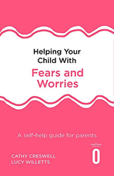
Helpful Resources
Apps:
Mindshift
Headspace
Self help for anxiety management (SAM)
Worry Box
Clear Fear
Hampshire CAMHS How To Beat Anxiety Workbook – www.hampshirecamhs.nhs.uk
Books:
Helping Your Child with Fears and Worries by Cathy Cresswell and Lucy Willetts
What To Do When You Worry Too Much by Dawn Huebener
Notes:
HF
You can jot some of these ideas if you think any would be helpful to explore
Some of you may be aware that we offer a intervention to parents through our service following a referral that uses the Helping Your Child book. We recommend this book to parents even if they are not attending the intervention as it is easy to access and has some great tips.

Slide 20
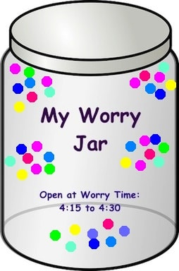
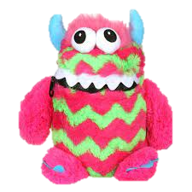
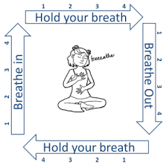
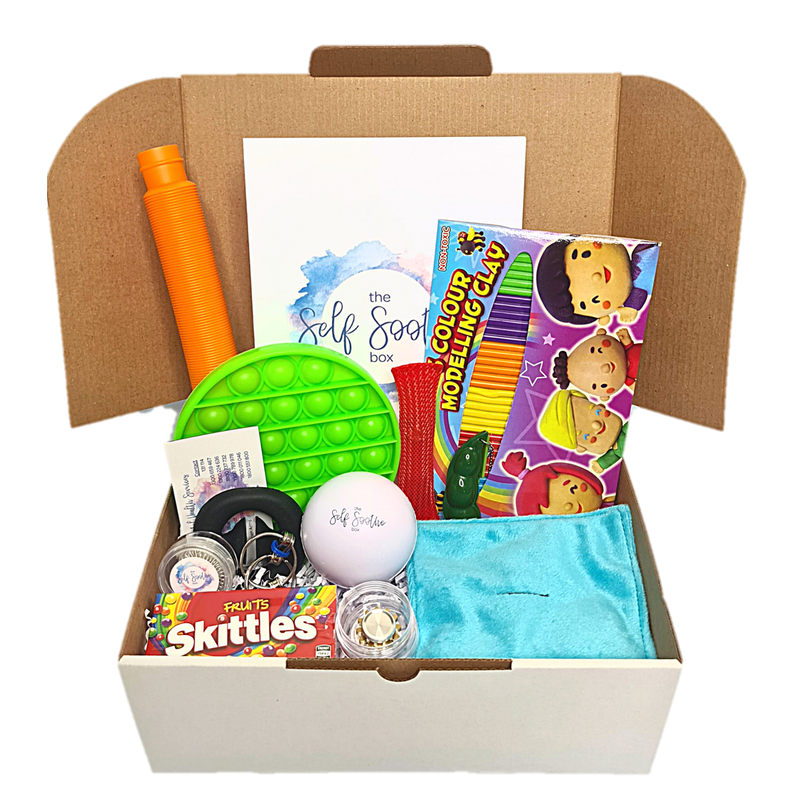
Helpful Resources:
Activities
Breathing Techniques
Worry Jar/Monster
Self-Soothe Box
https://hampshirecamhs.nhs.uk/video/5-of-7-make-your-own-self-soothe-box/
Notes:
KM
Hot chocolate
Mountain breathing
Physiological sigh

Slide 21
Thank you
for listening
Notes:
Return to flip chart and ensure all has been answered.
If you need further help/support with your child’s anxiety speak to your Mental Health Lead
Thank you!

